Slide 1
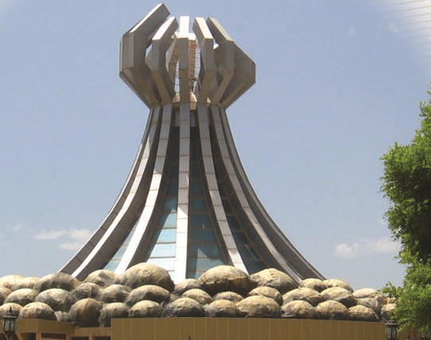
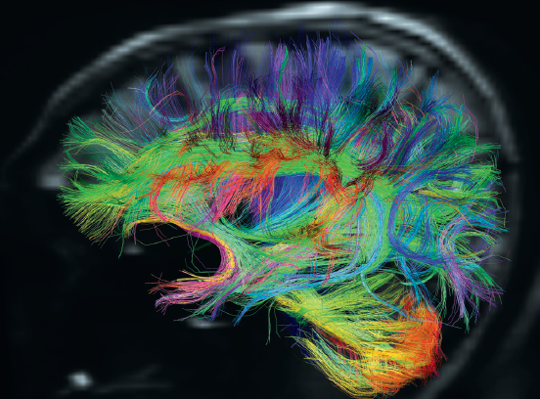

Human Pain and Suffering: Insights from Buddhism and Mind-Body Medicine Ahmad Sohrabi, PhD
5th Mesopotamia Medical Congress, Slemani, 2013

Slide 2
Some theory

Slide 3
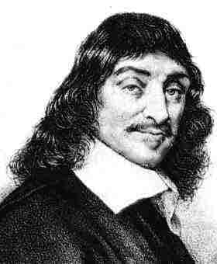
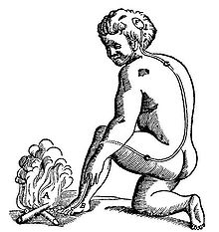
Early mind-body views:
Plato, Aristotle
Descartes:

Slide 4
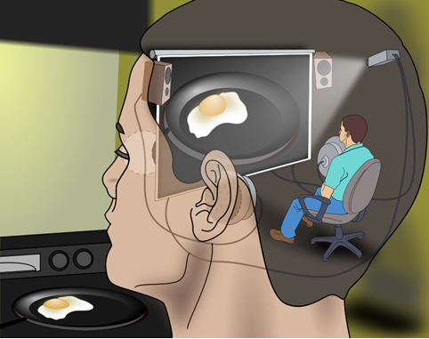
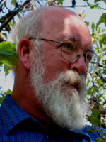
Homunculus:
“The persuasive imagery of the Cartesian Theater keeps coming back to haunt us—laypeople and scientists alike—even after its ghostly dualism has been denounced and exorcized.”
—Daniel Dennett

Slide 5
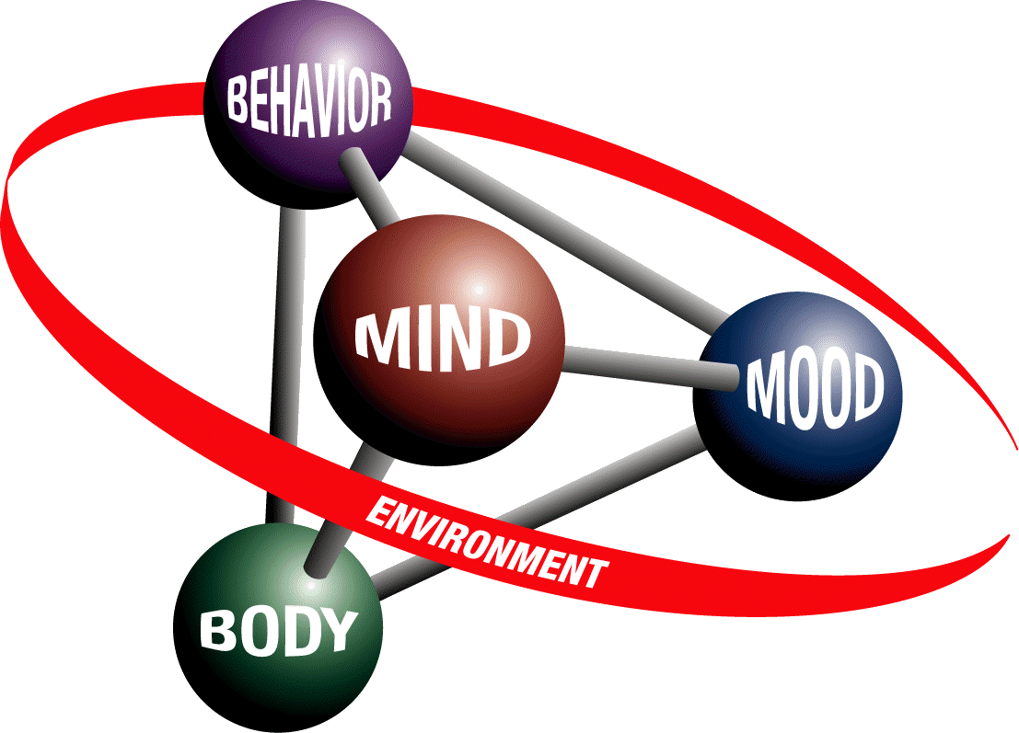
Cognitive science

Slide 6
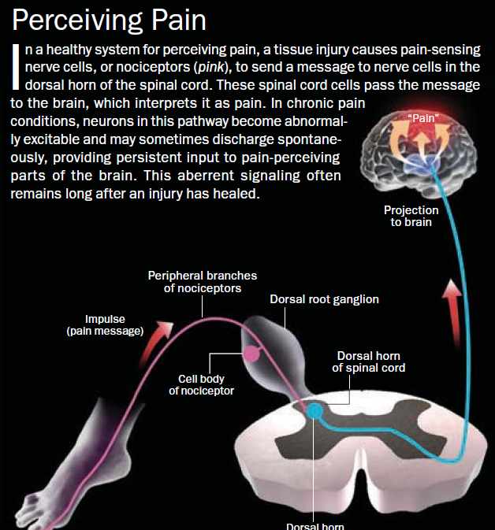
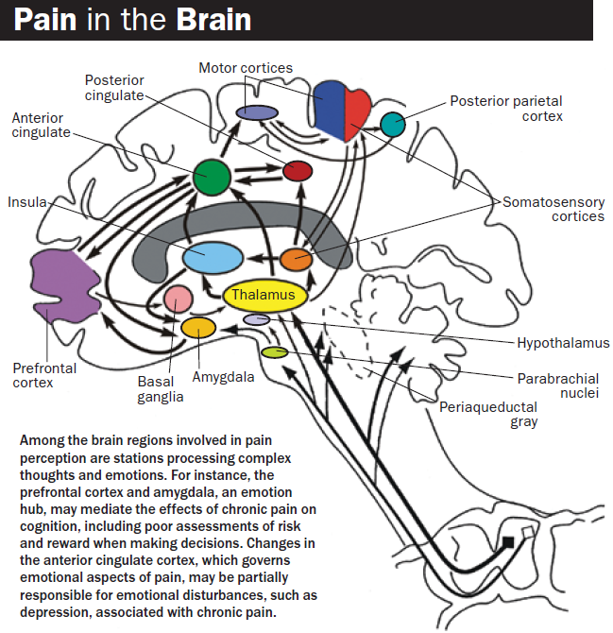

Slide 7
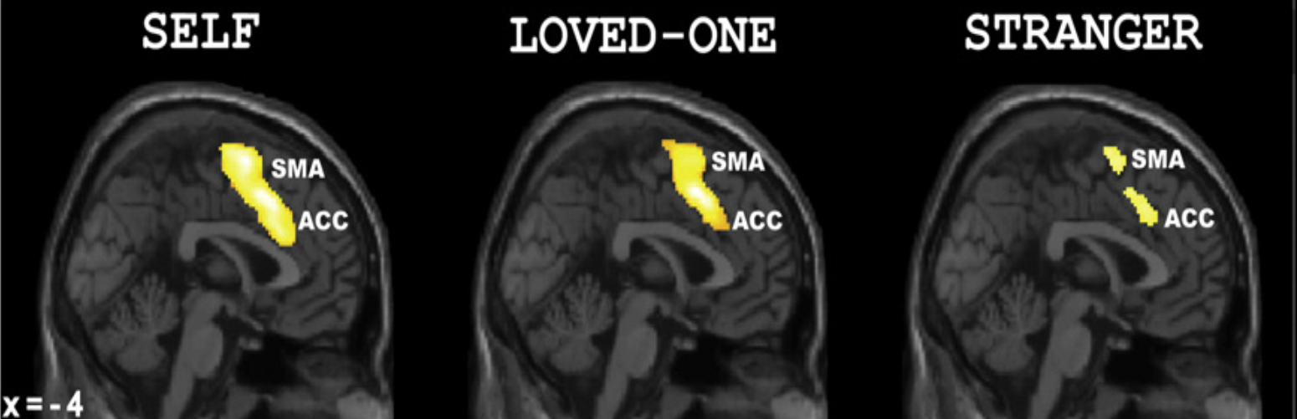
When imagining a loved-one in pain, brain activation is similar to when ourselves in pain, but not when imagining a stranger (Chang et al., 2010)

Slide 8
Applications

Slide 9
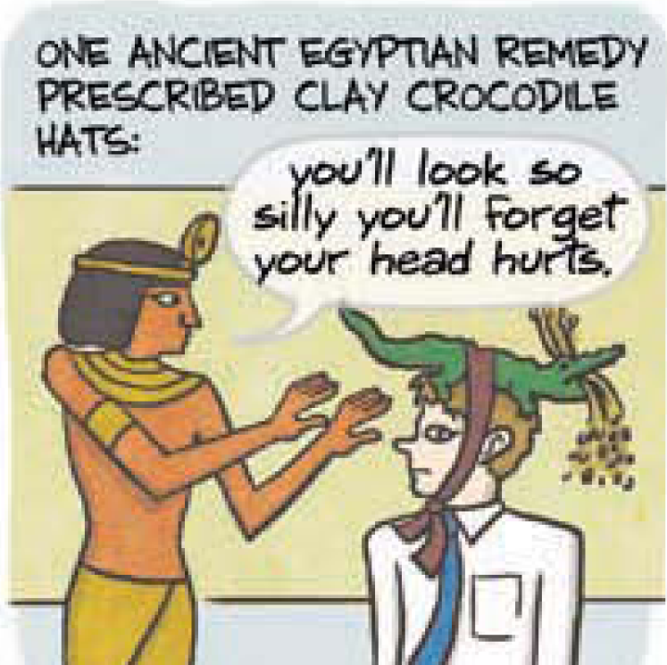

Slide 10
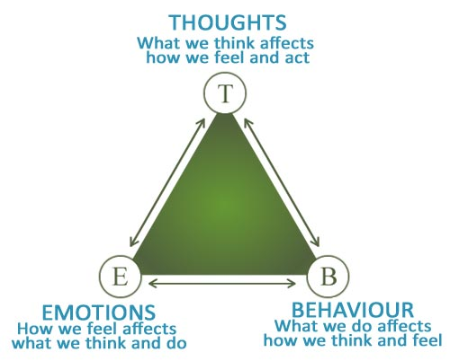
Modern cure: Cognitive Therapy: CBT

Slide 11
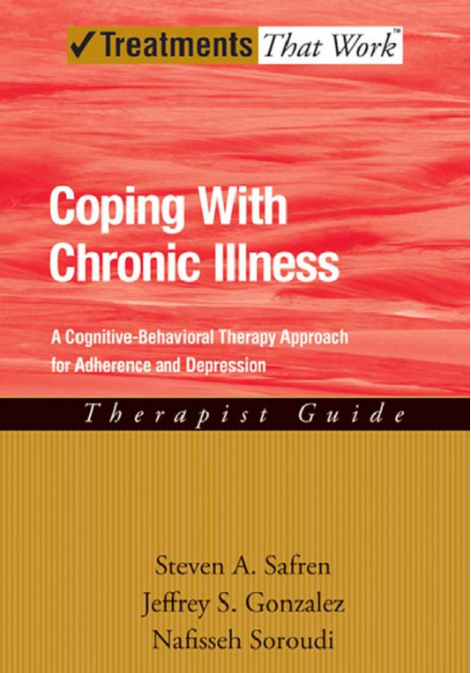
CBT for Chronic Diseases

Slide 12
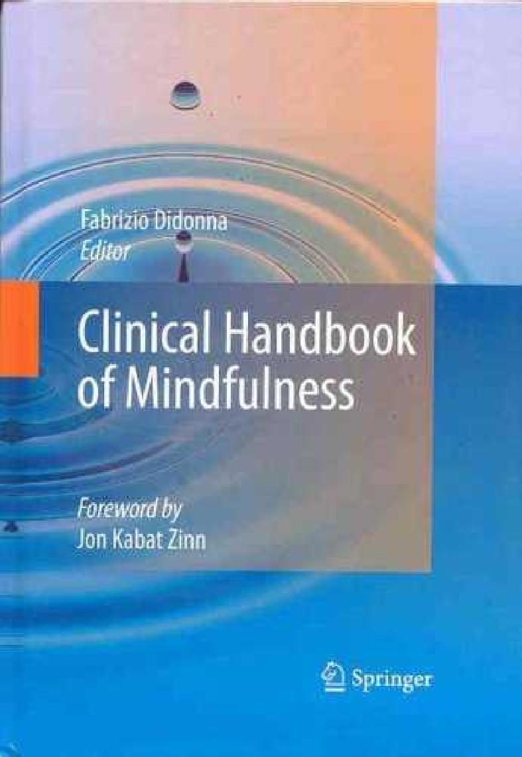
Integrating Buddhist/Mindfulness Based CBT (MBCT)
Mindfulness: non-judgmental attention to present, moment by moment
Silenceness sparse emptiness openness stillness spaciousness
Thich Nhat Hanh: interbeing. Buddha:all of his years of teaching could be encapsulated into the one sentence: “Nothing is to be clung to as I, me, or mine.

Slide 13
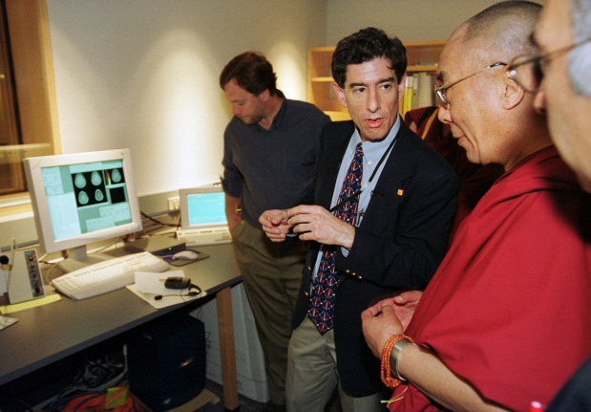
a combination of knowing and not knowing
anicca, anatta, dukkha, the kelesas, the four foundations of mindfulness
the four immeasurables (Brama Viharas — loving kindness, compassion, empathic joy, and equanimity)

Slide 14
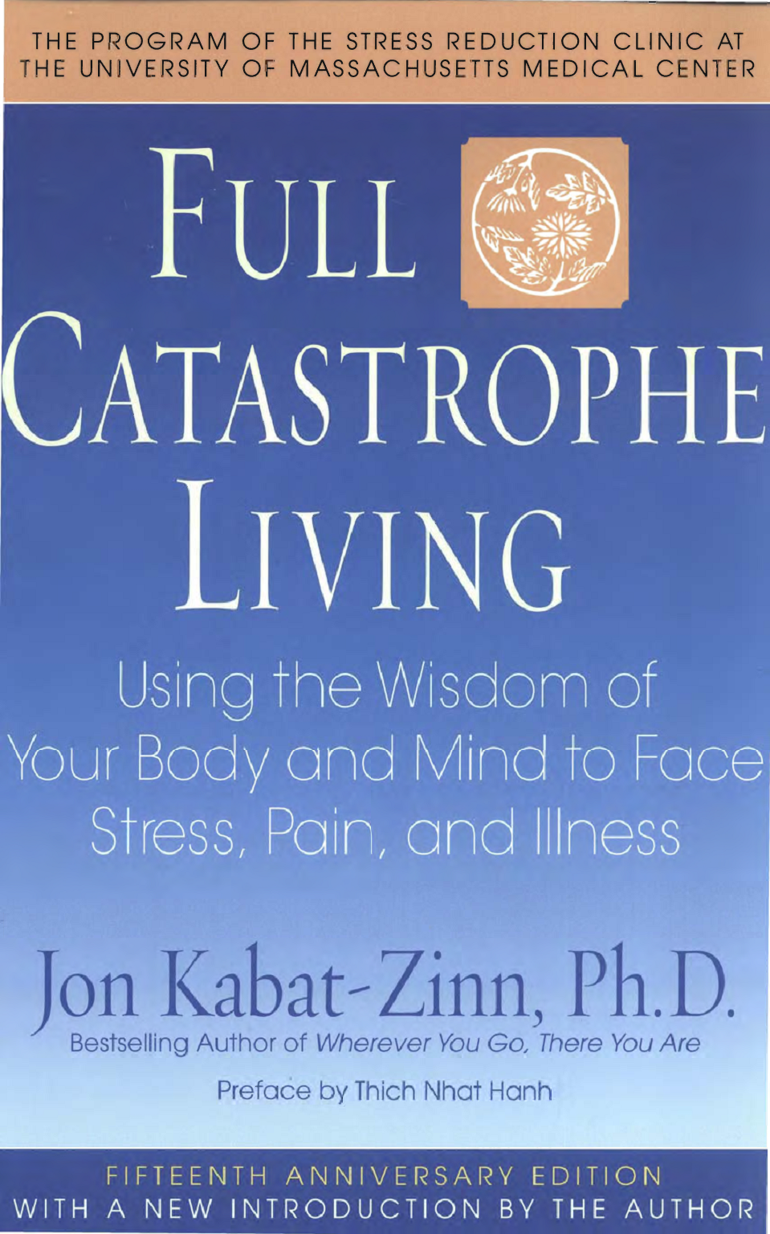
Mindfulness-Based Stress Reduction (MBCT)

Slide 15
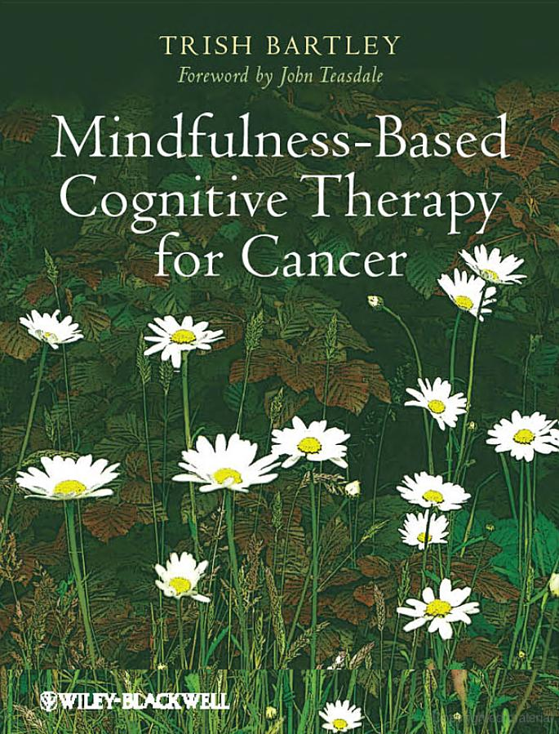
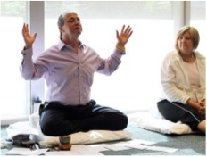
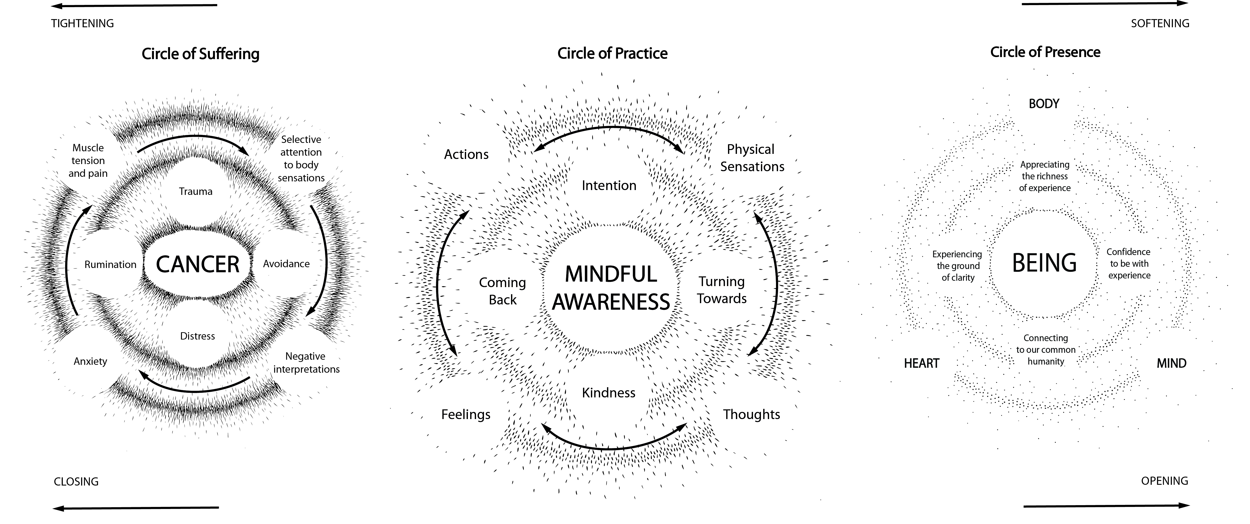
MBCT for Chronic Deseases

Slide 16
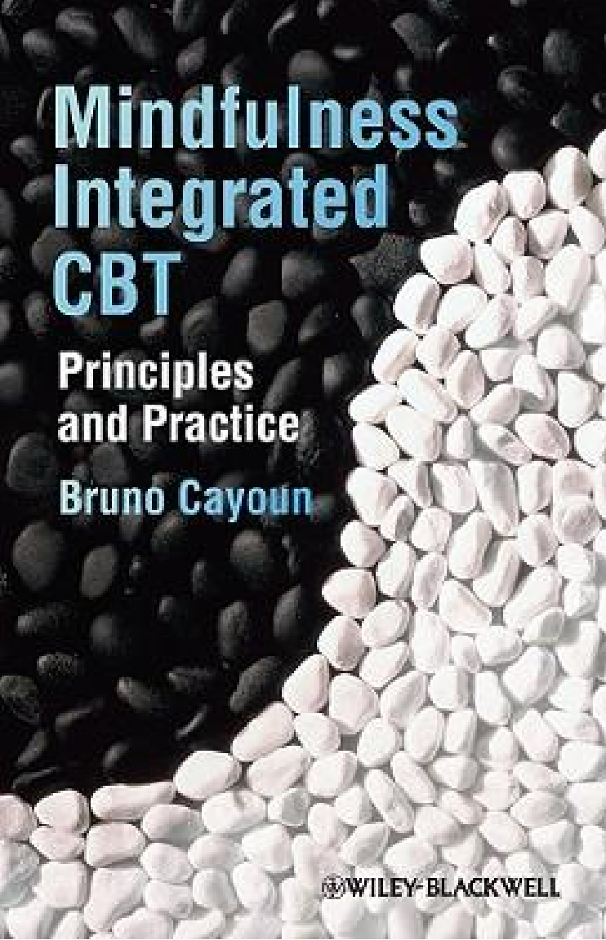
Helping Patients with Diabetes

Slide 17
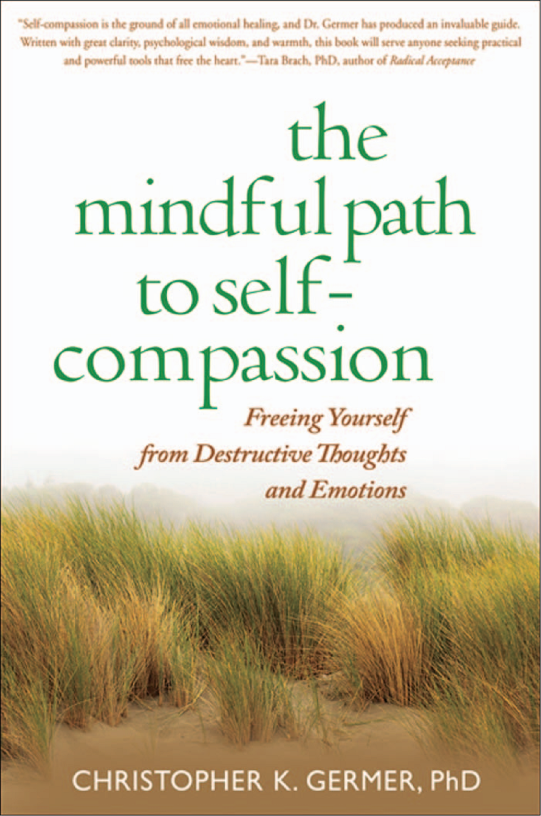
Loving-kindness Meditation
Imaging loved one, self, others, difficult ones

Slide 18

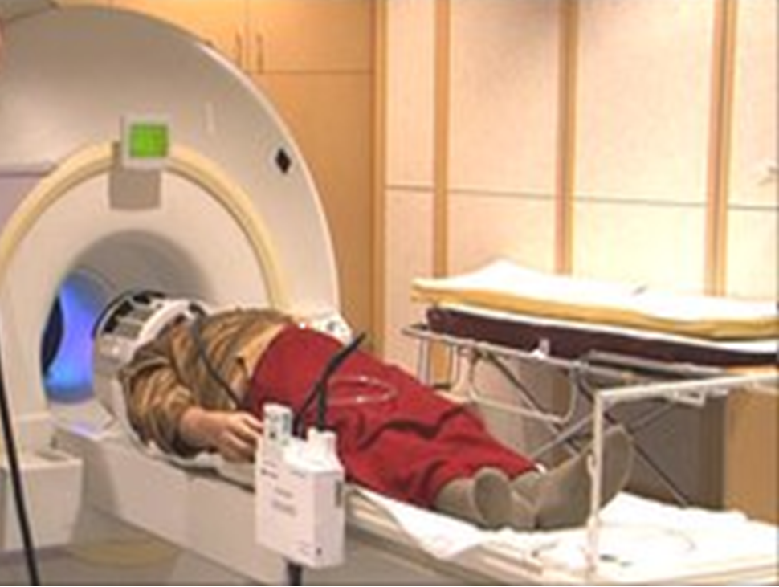
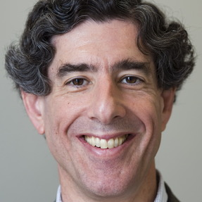
Meditation
fourteen meditators were doing breath meditation inside the MRI scanner (Hasenkamp et al., 2012)

Slide 19
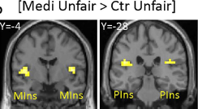
Insula is more activated by unfairness in meditator than non-meditators

Slide 20
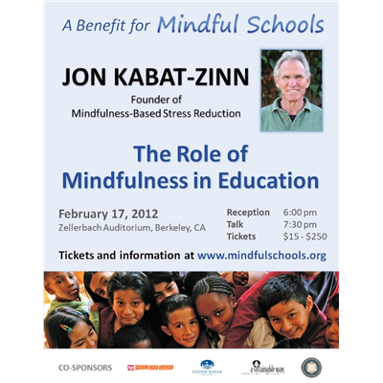

Mindful Education

Slide 21
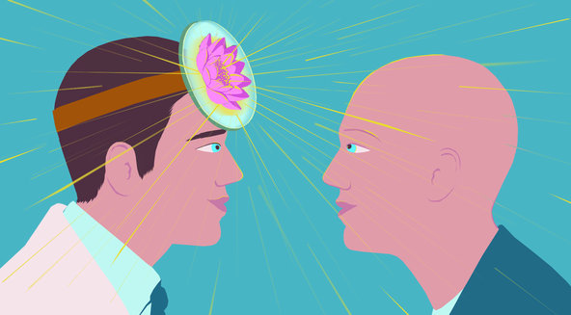
Mindfulness for Doctors

Slide 22

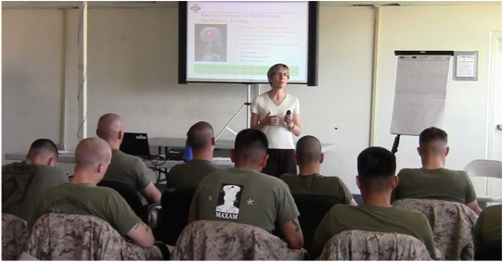
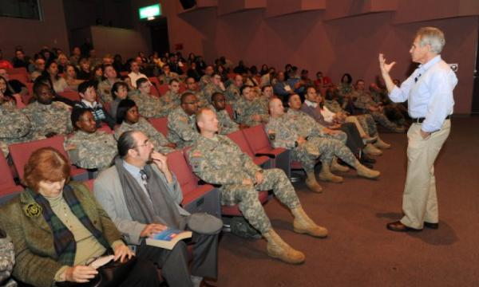
Mindfulness in Army

Slide 23
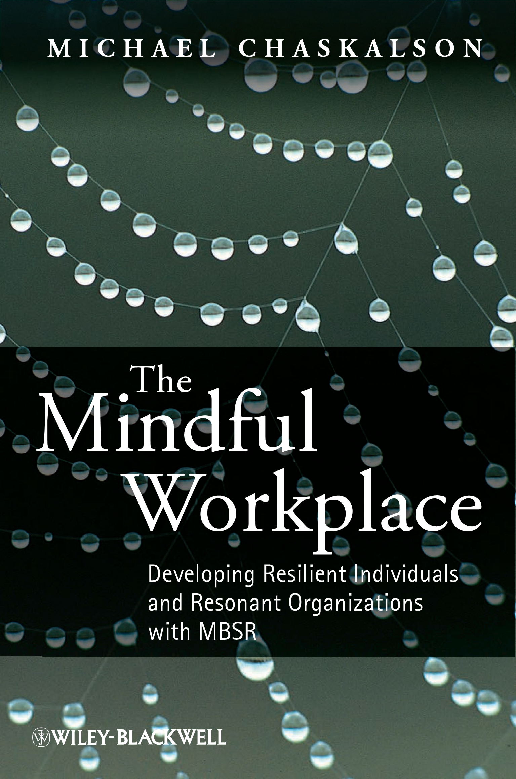
Stress and Interpersonal Relationship at Work

Slide 24
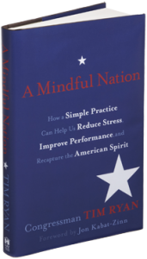
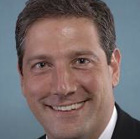
Mindful Nation: Congressman Tim Ryan

Slide 25
Conclusion
Mindfulness can help in many areas from schools to hospitals and from workplace to government
affects the brain/mind, as shown by fMRI and behavioural data
has health and social benefits
So, reducing pain and suffering in the whole nation

